Slide 1
TWITTER HERON
By
Akhilesh Gattu (5)
Latha Muddu (15)

Slide 2
Heron
Better debugging capabilities
Performance
Easy to manage

Slide 3
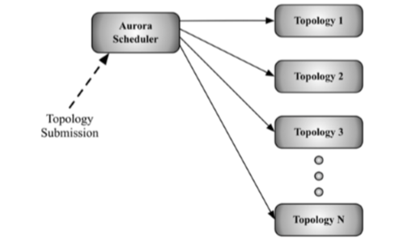
Architecture

Slide 4
Aurora scheduler
Users employ heron api to create and deploy topologies to aurora scheduler
Aurora scheduler schedules each tak as and when to be performed

Slide 5
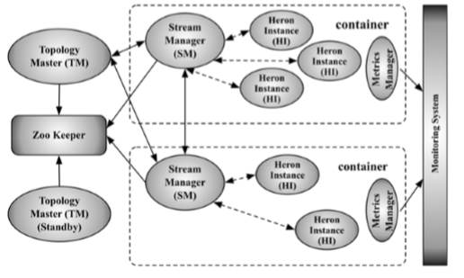
Heron architecture

Slide 6
Topology master – responsible for managing topology throughout the existence of the topology
Zokeeper -
Stream manager- task is to route of tuples efficiently
Metrics manager – collects and exports metrics from all the components in the system

Slide 7
Tuple Processing
At most once - no tuple is processed more than once, although some tuples may be dropped, and thus may miss being analyzed by the topology
At least once - – each tuple is guaranteed to be processed at least once, although some tuples may be processed more than once, and may contribute to the result of the topology multiple times.

Slide 8
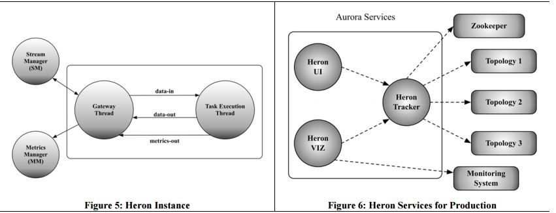
Heron instance and services

Slide 9
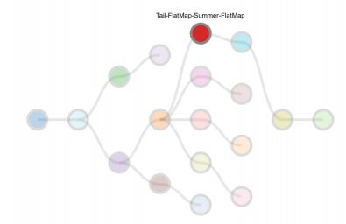
Heron Topology

Slide 10
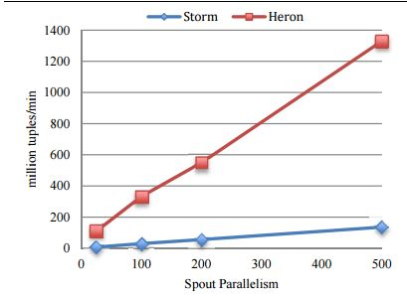
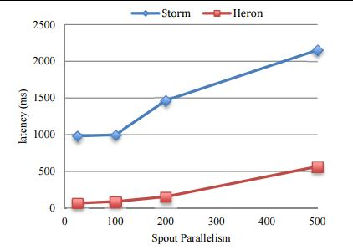
Heron vs storm Throughput and end to end latency

Slide 11
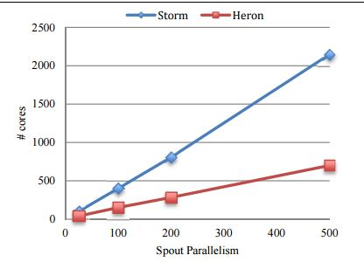
Heron vs storm cpu usage

Slide 12
Explanation

Slide 13
Twitter use case

Slide 14
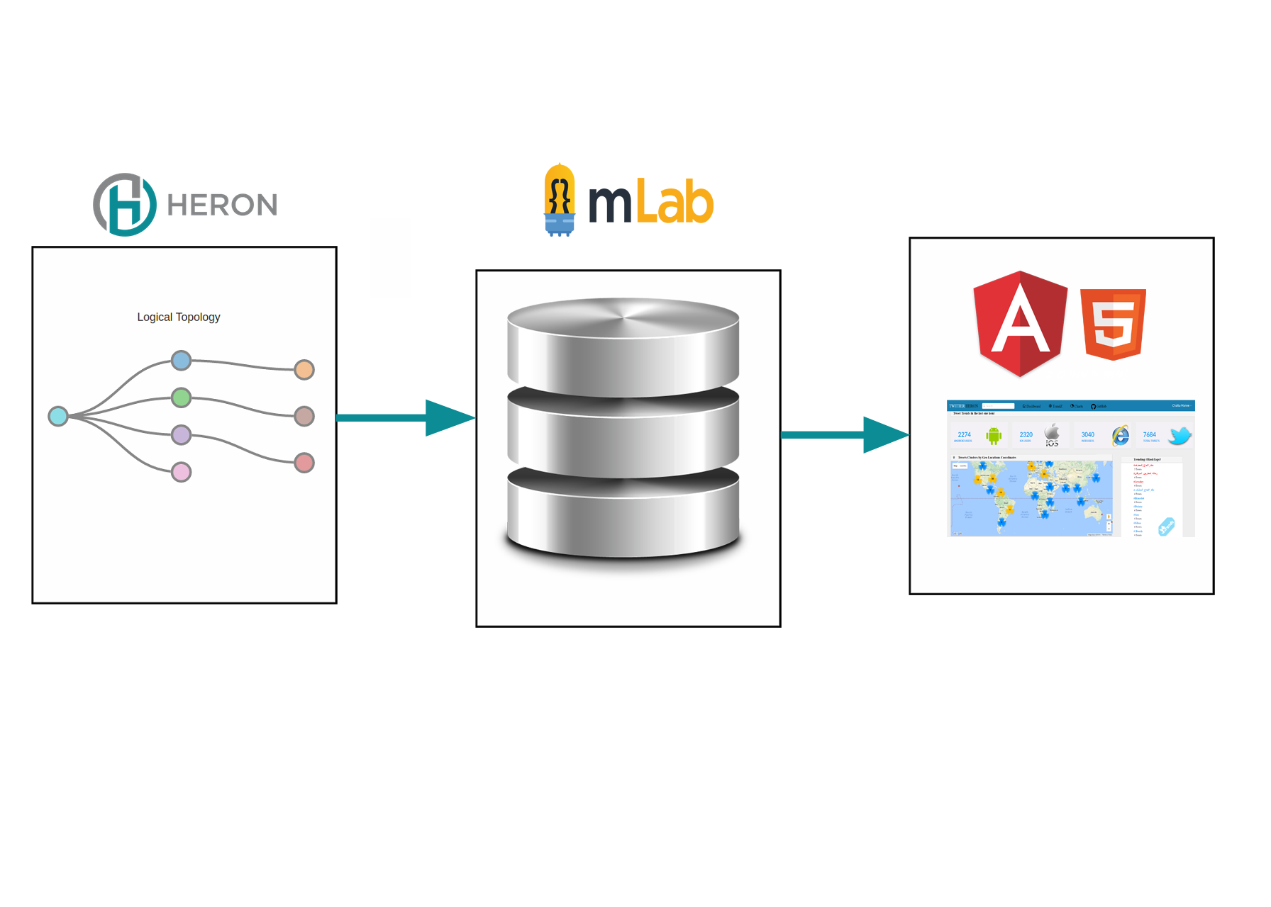
Twitter heron Use case architecture

Slide 15
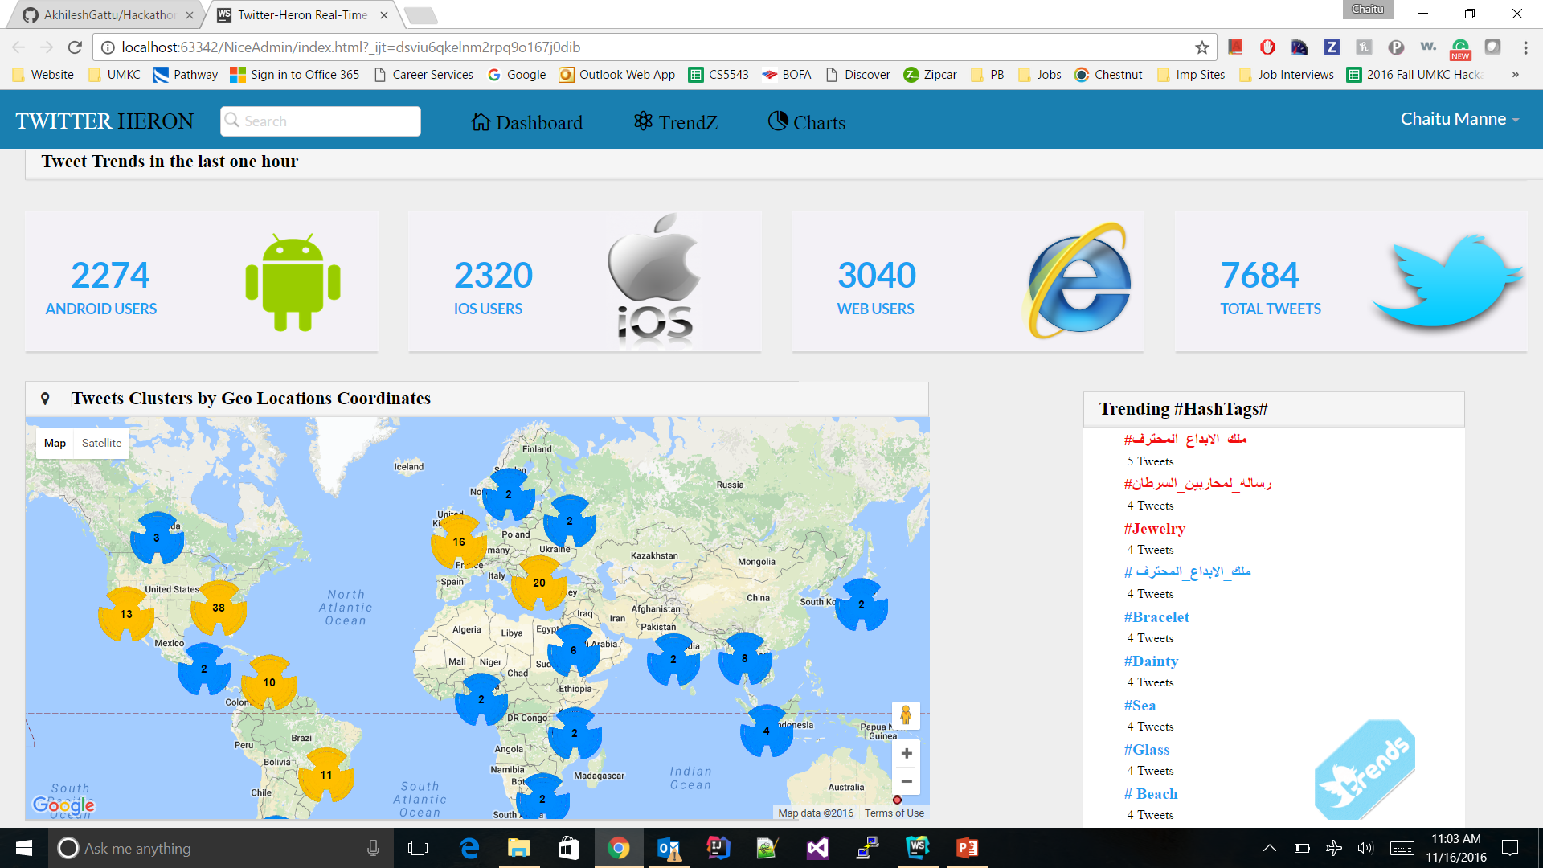
Implementation

Slide 16
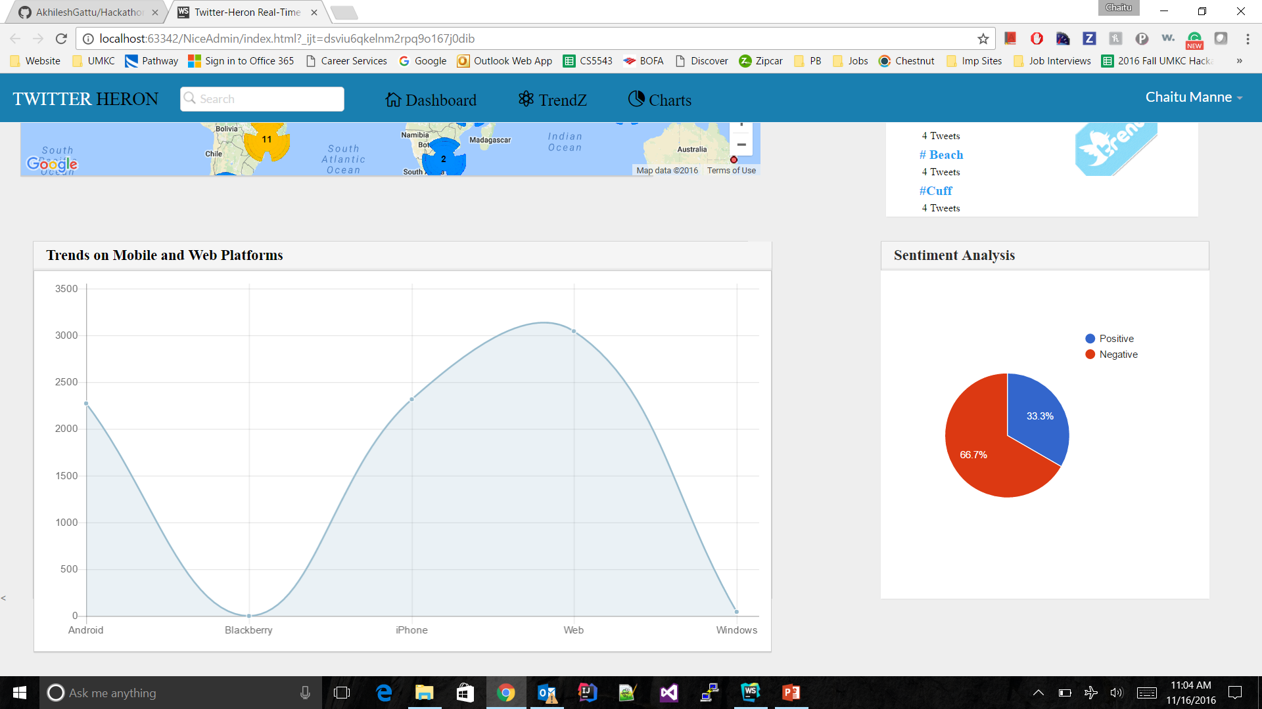
Cont..,

Slide 17
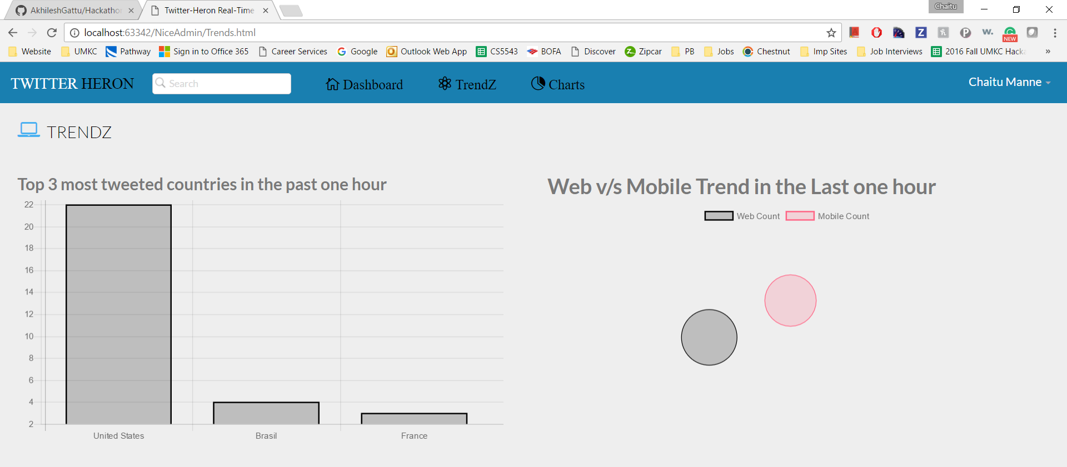
Cont..,

Slide 18


Slide 19


